Slide 1

DATA ANALYSIS PROJECT
ROCKBUSTER STEALTH LLC
(Shanza Khalid)

Slide 2

Background
Rockbuster Stealth LLC specialized in a model where customers would rent movies from one of their stores around the world. Rockbuster now faces competition from streaming services such as Netflix and Amazon Prime.
To stay competitive, the Rockbuster Stealth management team plans to use its existing movie licenses to launch an online video rental service.

Slide 3
Objective & Key Questions
Objective
Analyze Rockbuster payment, film inventory, and customer data to develop insights that will inform the 2020 strategy to expand into the online video rental space.
Key Questions
Which movies contributed the most/least to revenue gain?
What was the average rental duration for all videos?
Which countries are Rockbuster customers based in?
Where are customers with a high lifetime value based in?
Do sale figures vary between geographic regions?

Slide 4

Analysis

Slide 5
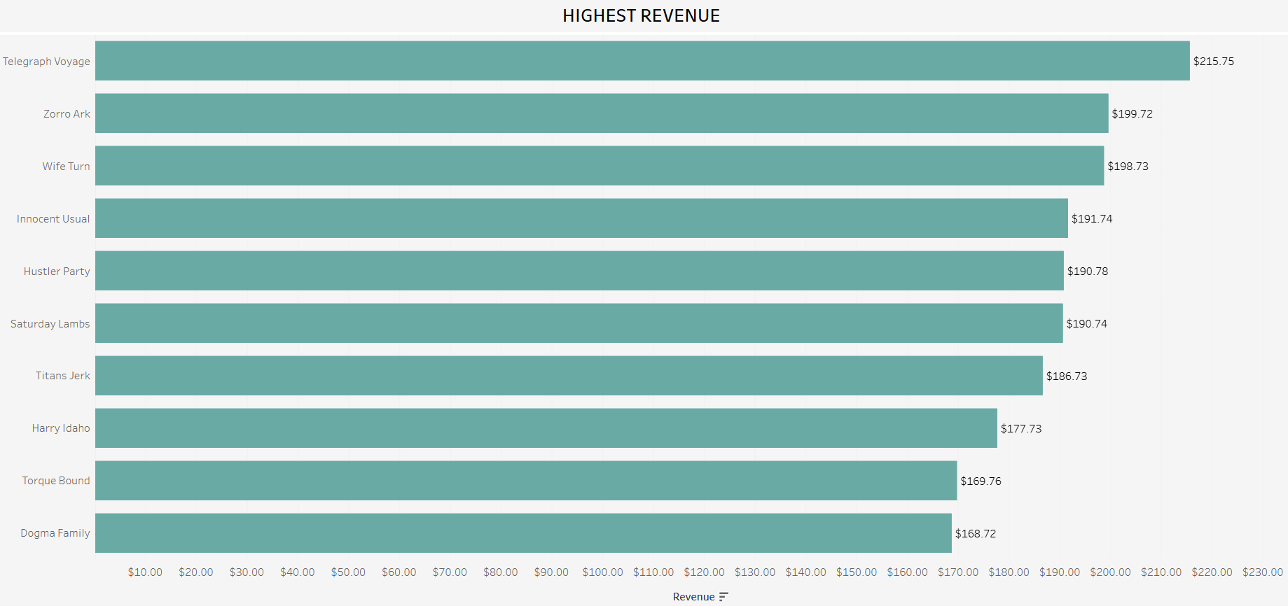
Which Movies Generated the Most Revenue?
The bar graph shows the top ten movies that generated the most revenue. These movies generated 3.1% of Rockbuster’s total revenue. This suggests that while these may be some of the most popular movies, most of revenue generated is spread amongst several more movies in the Rockbuster inventory.

Slide 6
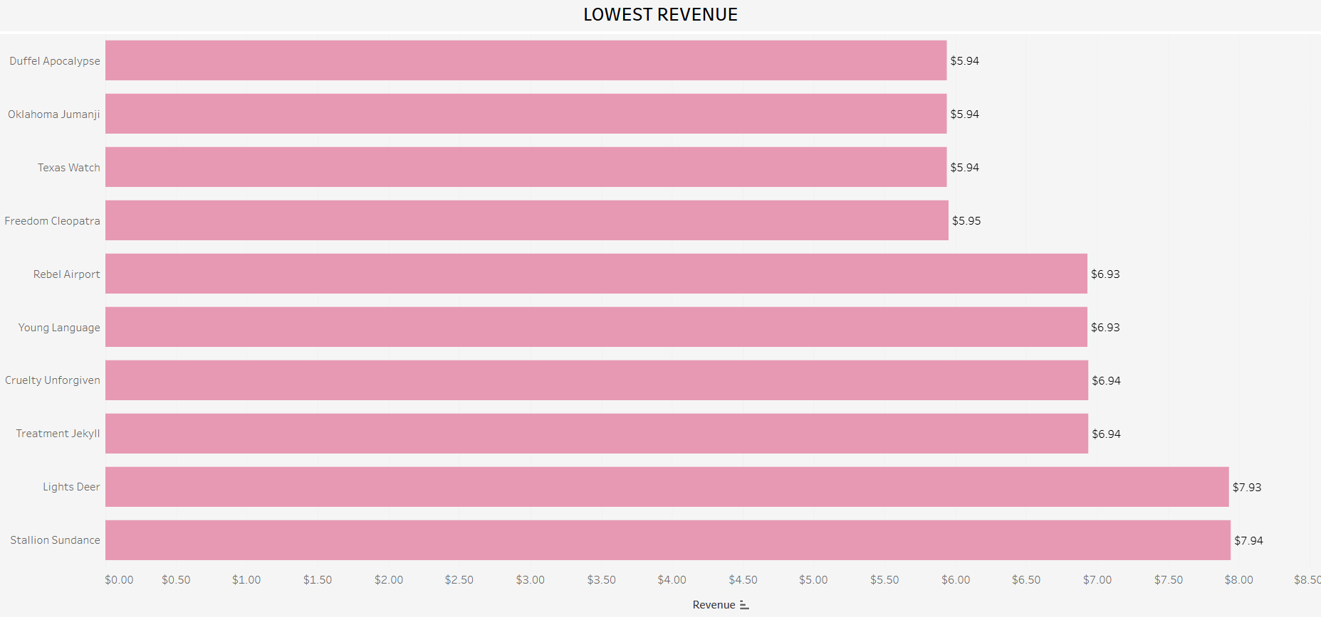
Which Movies Generated the Least Revenue?
The bar graph shows the top ten movies that generated the least revenue. These movies generated 0.1% of Rockbuster’s total revenue, which suggests that these are the least rented movies and that most of revenue generated is spread amongst several more movies in the Rockbuster inventory.

Slide 7
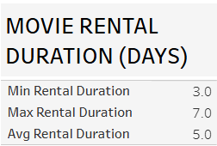
What is the Average Movie Rental Duration?
Across all movies, the average duration of days customers rented movies was five days with the shortest duration being three days and the longest being seven days.

Slide 8
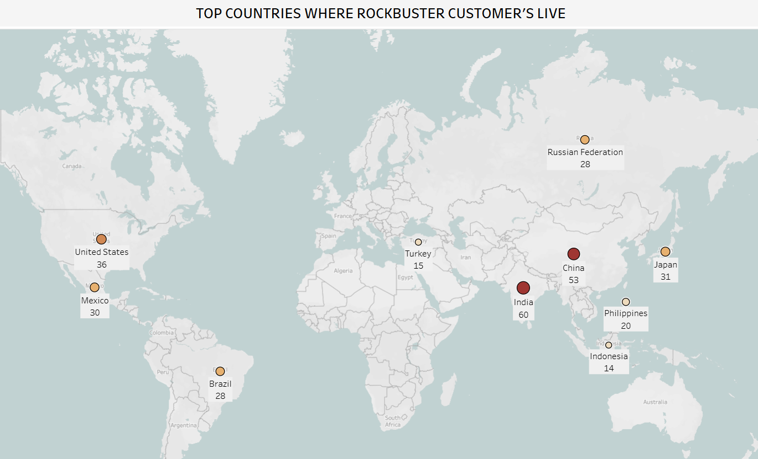
Which Countries are Customers Based In?
The map reveals the top ten countries where Rockbuster customers reside. Most customers are based in Asia. The top two countries are India and China.

Slide 9
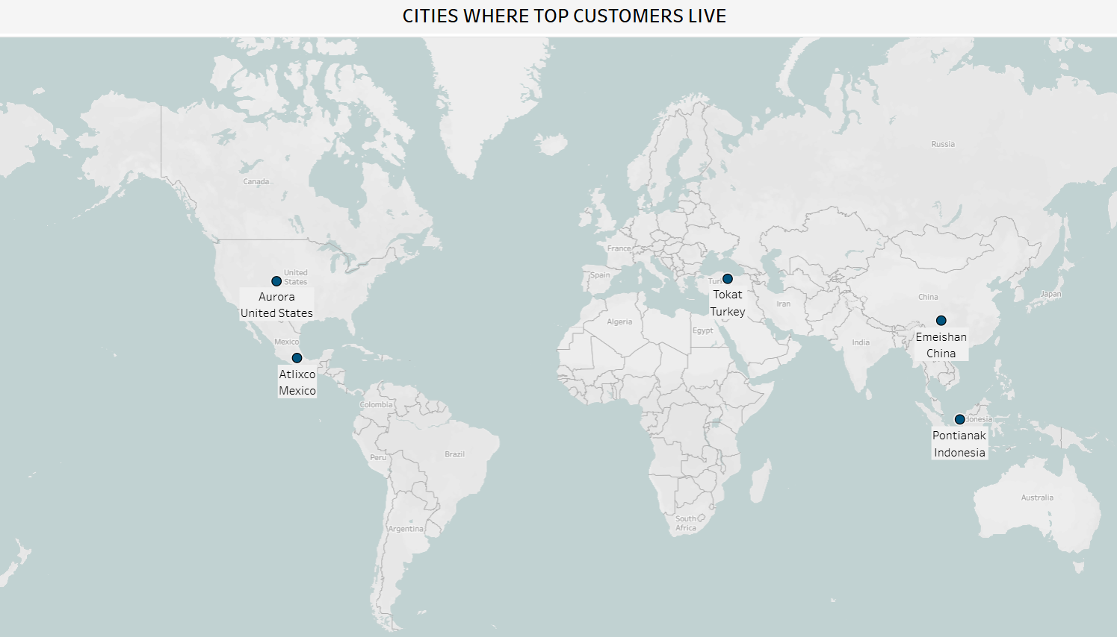
Where Do High Lifetime Value Customers Live?
Customer (First name, Last Name) | City, Country | Total Payment
Casey Mena | Tokat, Turkey | $ 130.68
Sara Perry | Atlixco, Mexico | $ 128.70
Leslie Seward | Pontianak, Indonesia | $ 123.72
Alan Kahn | Emeishan, China | $ 119.75
Clinton Buford | Aurora, United States | $ 98.76
The map shows the top ten cities where the top five Rockbuster customers reside. These cities are also located in the top ten countries.
The top five customers are listed in the table. Two of the customers live in Asian cities.

Slide 10
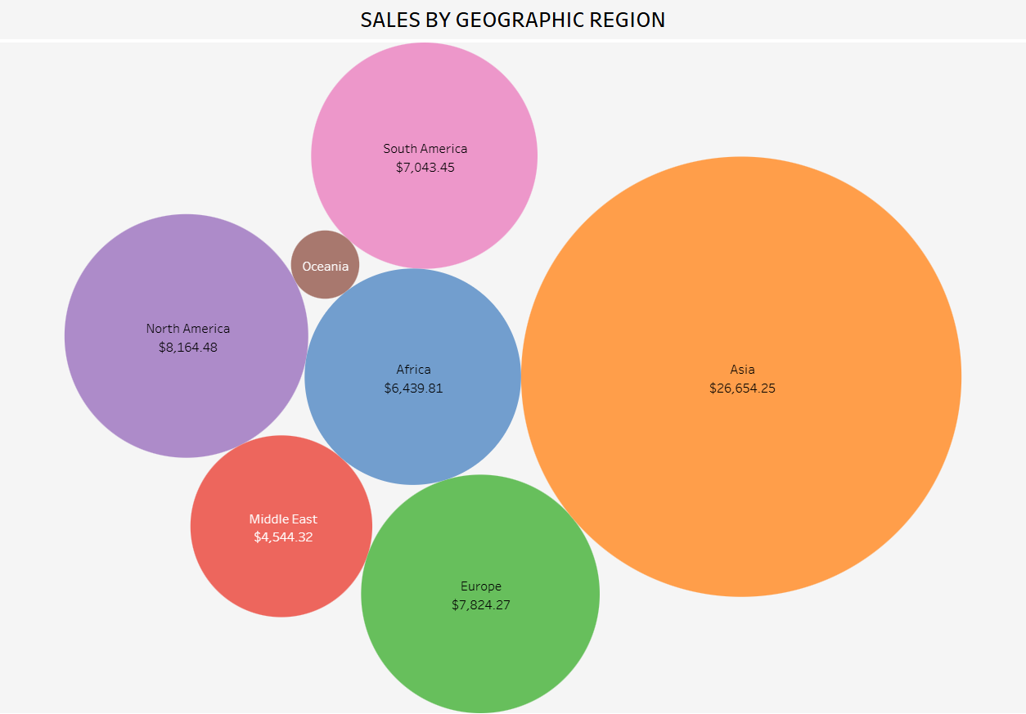
Do Sales Values Differ Between Regions?
Asia led all the regions by contributing $26,654.25, which accounts for 43.5% of ROCBUSTER’S total revenue.

Slide 11
Key Findings & Recommendations
Key Findings:
The top ten movies contributed to 3.1% of Rockbuster’s total revenue. This suggests that Rockbuster’s revenue is generated amongst multiple movies in their inventory.
The average rental duration for all videos is five days.
Of the top ten countries Rockbuster customers are based in, six of the ten are Asian countries.
The top five Rockbuster customers are based in the following cities: Tokat, Atlixco, Pontianak, Emeishan, and Aurora. Two of these customers are based in Asia.
Sales values vary among regions. Asia generated the most sales amongst all the regions.
Recommendations:
Further data analysis of movie rental data to include stratification by rental rate and rental length. This would enable us to better understand how rental rate and rental length impact the revenue generated by each movie.
Online movie rental duration from three-seven days.
Targeted marketing and sales in Asia to accommodate the large customer base, top Rockbuster customers, and to increase the revenue generated in Asia.
Incorporate more films in Asian languages.

Slide 12

Q&A
Link to Tableau:
Presenting ROCKBUSTER’S SQL results by (SHANZA KHALID)

